Slide 1
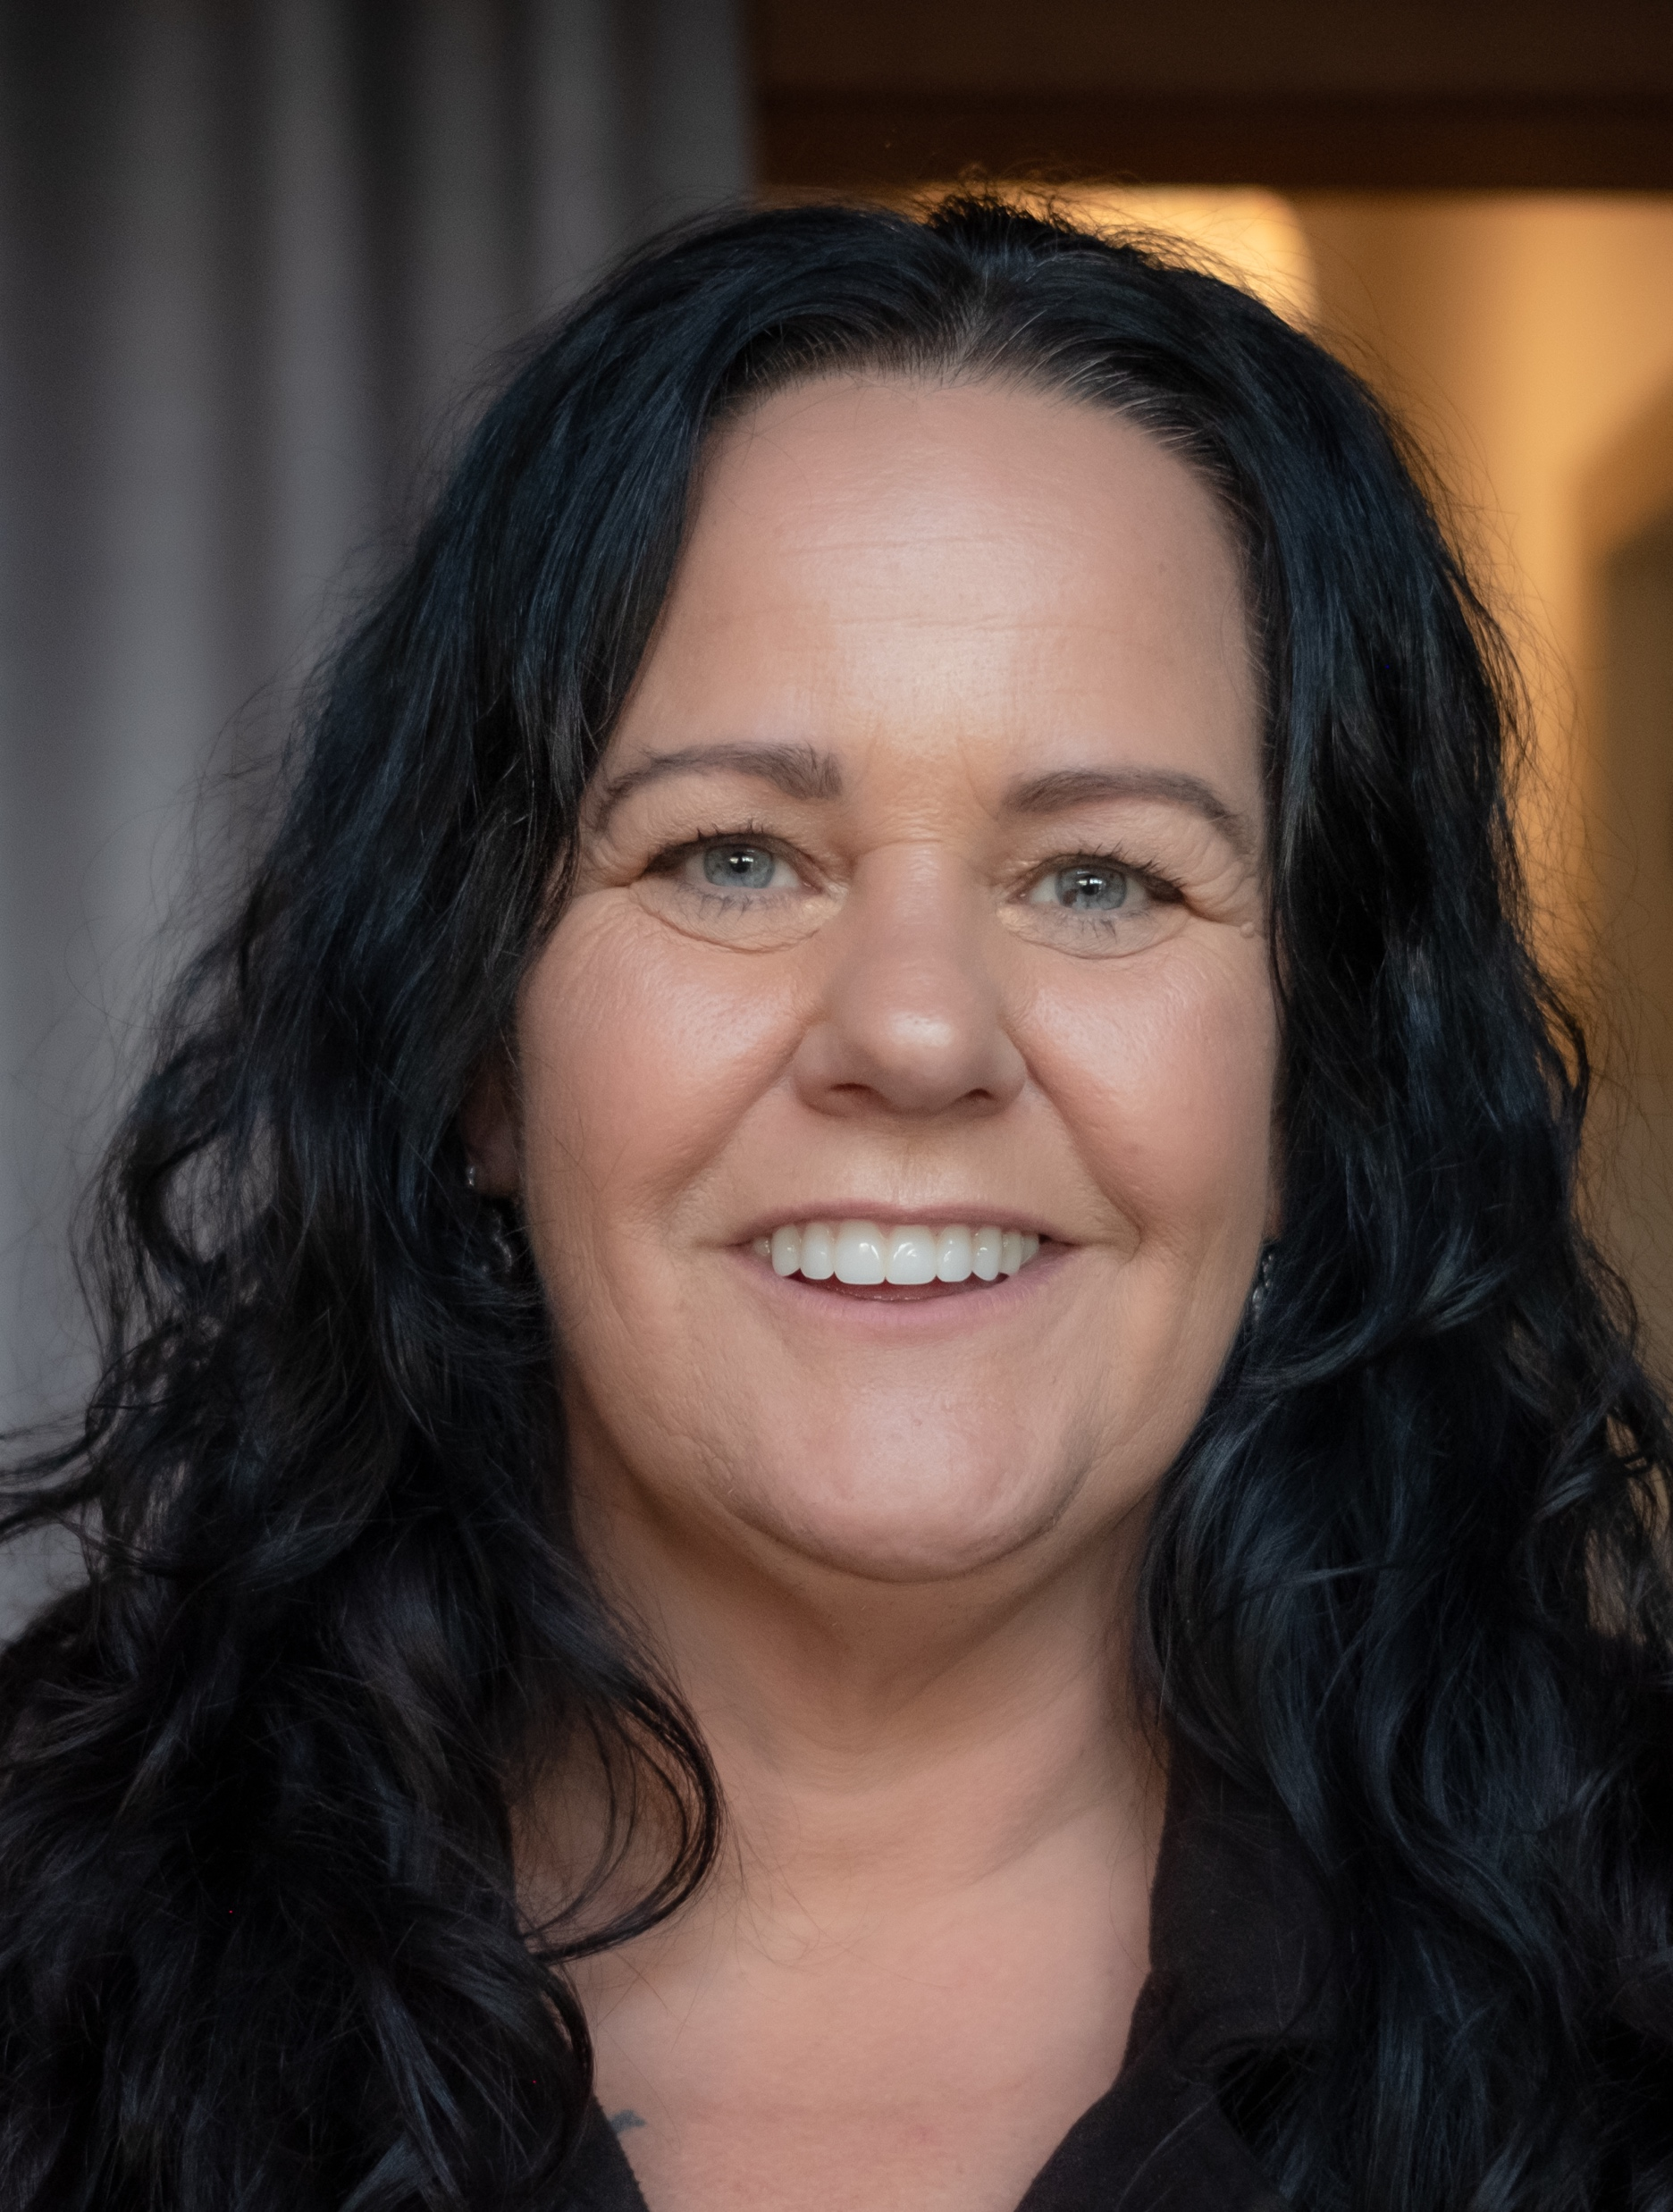
“It’s a very simple test that can give a lot of peace of mind”.
- Simone, Awabakal Country
Notes:
To change the photo, right-click in the centre of the image and select ‘change picture’, then upload the replacement photo.
Quote textbox is editable.

Slide 2
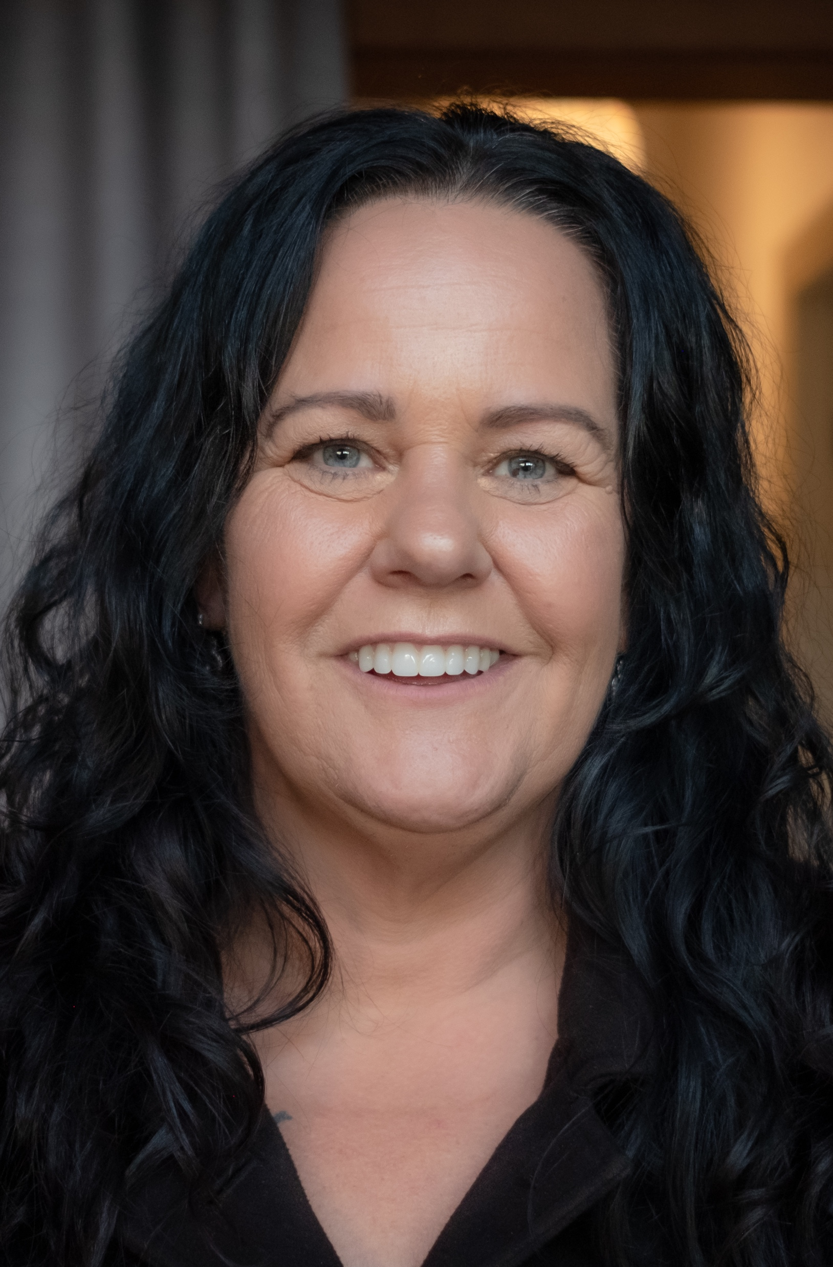
“The screening test takes five minutes, but it could save your life”.
- Simone, Awabakal Country
Notes:
To change the photo, right-click in the centre of the image and select ‘change picture’, then upload the replacement photo.
Quote textbox is editable.

Slide 3
“Come on you mob, it’s a quick and simple test that could save your life”.
- Simone, Awabakal Country
Notes:
To change the photo, right-click in the centre of the image and select ‘change picture’, then upload the replacement photo.
Quote textbox is editable.

Slide 4
“It’s a very simple test that can give a lot of peace of mind”.
- Simone, Awabakal Country
Notes:
To change the photo, right-click in the centre of the image and select ‘change picture’, then upload the replacement photo.
Quote textbox is editable.

